Slide 1

Historical data borrowing for non-inferiority assessment Hui Quan DIA BSWG KOL Webinar Series March 19, 2021

Slide 2
Acknowledgements
Zhixing Xu
Meehyung Cho
Yingwen Dong
Nan Jia

Slide 3
Outline
Background
Hypotheses
Methods: propensity score data matching borrowing: synthesis and two-confidence-interval approaches
Conditional power or type I error probability
Assessment of effectiveness after NI claim
Bayesian historical data borrowing
Example
Simulation results
Discussion

Slide 4
Background
Non-Inferiority (NI) assessment for evaluating
A test treatment can preserve a proportion of the treatment effect of an active control compared to placebo
FDA issued guidance in 2016 focusing on:
With the demonstration of the effect of an active control in historical studies, it will be unethical to include placebo in any follow up trials
One goal is to show that the difference between the new test drug and active control is small enough to support the conclusion that the new drug is effective
There are NI trials not for showing effectiveness: e.g., safety trials

Slide 5
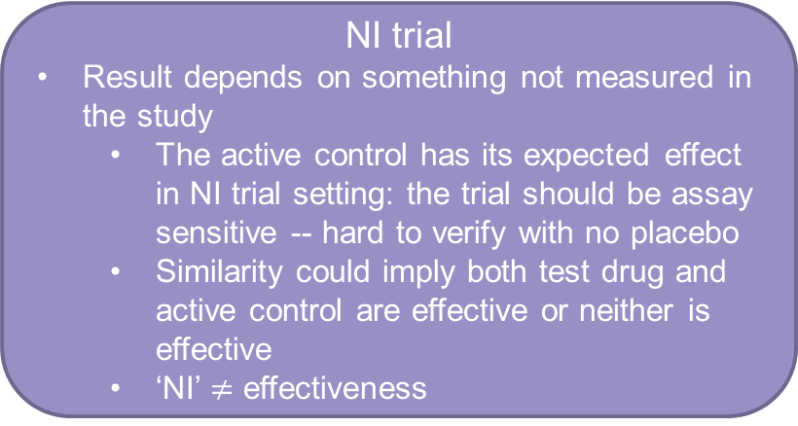
Background and FDA guidance
Two categories of trials
First briefly highlight the FDA guidance on statistical approaches for NI margin specifications and NI assessment, then align the historical data borrowing methods with the guidance.
NI trial
Result depends on something not measured in the study
The active control has its expected effect in NI trial setting: the trial should be assay sensitive -- hard to verify with no placebo
Similarity could imply both test drug and active control are effective or neither is effective
‘NI’ $≠$ effectiveness
Superiority trial
Result is entirely interpretable without further assumptions
Result speaks for itself

Slide 6
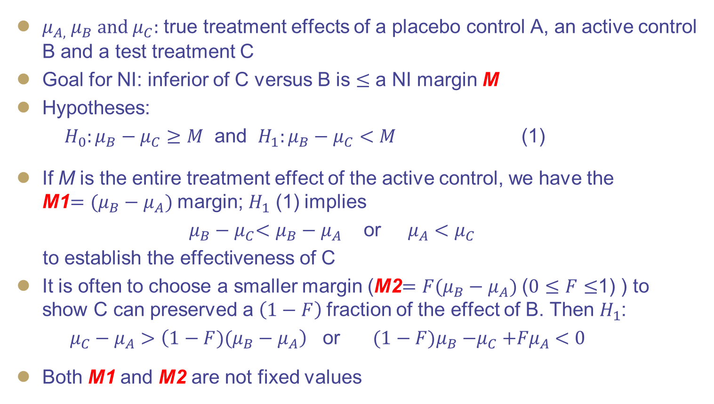
Hypotheses
$μ_{A, }{ μ}_{B} and μ_{C}:$ true treatment effects of a placebo control A, an active control B and a test treatment C
Goal for NI: inferior of C versus B is $≤$ a NI margin M
Hypotheses:
${H_{0}:μ_{B}−μ}_{C}≥M$ and ${H_{1}:μ_{B}−μ}_{C}<M$ (1)
If M is the entire treatment effect of the active control, we have the M1${=(μ_{B}−μ}_{A})$ margin; $H_{1}$ (1) implies
${ μ_{B}−μ}_{C}<$ ${μ_{B}−μ}_{A}$ or ${ μ_{A}<μ}_{C}$
to establish the effectiveness of C
It is often to choose a smaller margin (M2${=F(μ_{B}−μ}_{A})$ ($0≤F≤$1) ) to show C can preserved a $\left(1−F\right)$fraction of the effect of B. Then $H_{1}$:
${μ_{C}−μ}_{A}>\left(1−{F)(μ_{B}−μ}_{A}\right)$ or ${(1−F)μ_{B}{−μ}_{C}+Fμ}_{A} <0$
Both M1 and M2 are not fixed values

Slide 7
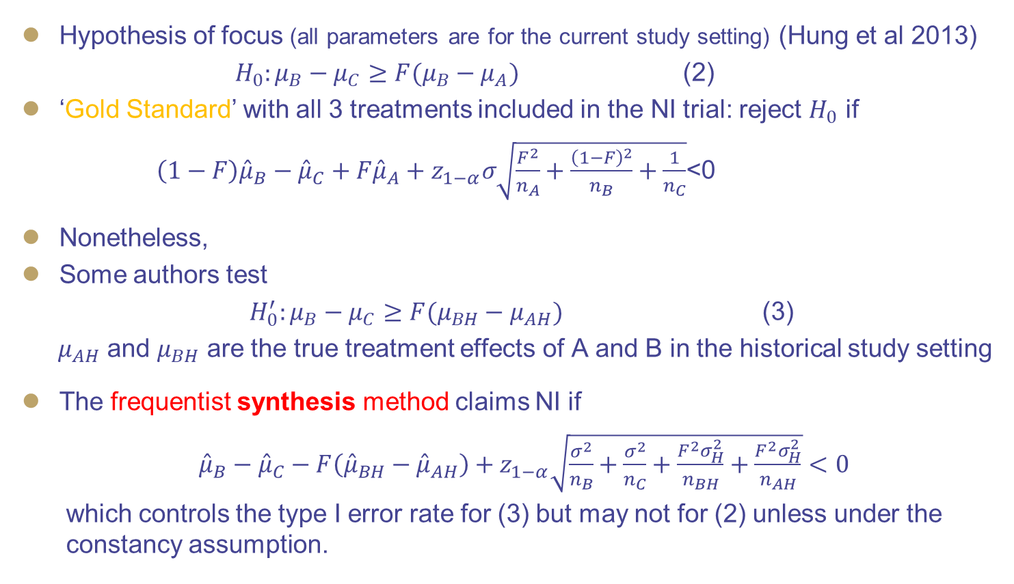
Frequentist methods (1/2)
Hypothesis of focus (all parameters are for the current study setting) (Hung et al 2013)
${H_{0}:μ_{B}−μ}_{C}≥{F(μ_{B}−μ}_{A})$ (2)
‘Gold Standard’ with all 3 treatments included in the NI trial: reject $H_{0}$ if
${{\left(1−F\right)\hat{μ}}_{B}−\hat{μ}}_{C}+F{\hat{μ}}_{A}+z_{1−α}σ\sqrt{\frac{F^{2}}{n_{A}}+\frac{{\left(1−F\right)}^{2}}{n_{B}}+\frac{1}{n_{C}}}$<0
Nonetheless,
Some authors test
${H_{0}^{′}:μ_{B}−μ}_{C}≥{F(μ_{BH}−μ}_{AH})$ (3)
$μ_{AH}$ and $μ_{BH}$ are the true treatment effects of A and B in the historical study setting
The frequentist synthesis method claims NI if
${\hat{μ}}_{B}−{\hat{μ}}_{C}−F\left({\hat{μ}}_{BH}−{\hat{μ}}_{AH}\right)+z_{1−α}\sqrt{\frac{σ^{2}}{n_{B}}+\frac{σ^{2}}{n_{C}}+\frac{F^{2}σ_{H}^{2}}{n_{BH}}+\frac{F^{2}σ_{H}^{2}}{n_{AH}}}<0$
which controls the type I error rate for (3) but may not for (2) unless under the constancy assumption.
B>A in historical study
unethical to have A in NI trial

Slide 8
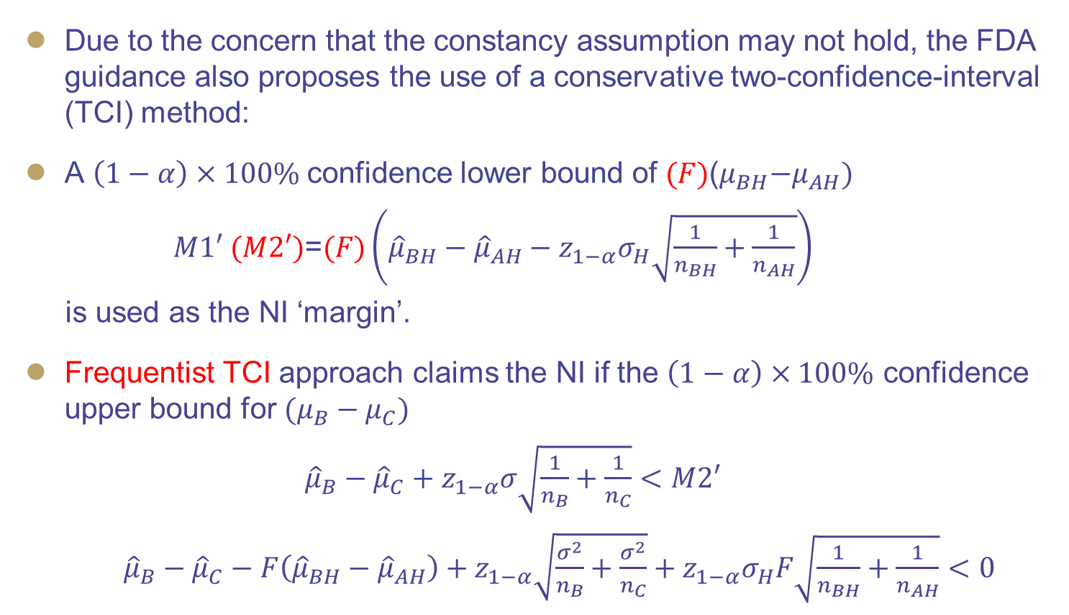
Frequentist methods (2/2)
Due to the concern that the constancy assumption may not hold, the FDA guidance also proposes the use of a conservative two-confidence-interval (TCI) method:
A $\left(1−α\right)×100\%$confidence lower bound of ${(F){\text{(}μ}_{BH}−μ}_{AH})$
$M1′ (M2′)\text{=}(F)\left({\hat{μ}}_{BH}−{\hat{μ}}_{AH}−z_{1−α}σ_{H}\sqrt{\frac{1}{n_{BH}}+\frac{1}{n_{AH}}}\right)$
is used as the NI ‘margin’.
Frequentist TCI approach claims the NI if the $\left(1−α\right)×100\%$ confidence upper bound for ${(μ_{B}−μ}_{C})$
${\hat{μ}}_{B}−{\hat{μ}}_{C}+z_{1−α}σ\sqrt{\frac{1}{n_{B}}+\frac{1}{n_{C}}}<M2′$
${\hat{μ}}_{B}−{\hat{μ}}_{C}−F\left({\hat{μ}}_{BH}−{\hat{μ}}_{AH}\right)+z_{1−α}\sqrt{\frac{σ^{2}}{n_{B}}+\frac{σ^{2}}{n_{C}}}+z_{1−α}σ_{H}F\sqrt{\frac{1}{n_{BH}}+\frac{1}{n_{AH}}}<0$

Slide 9
Historical data borrowing
Recruiting patients is challenging particularly in rare disease areas
It is desirable to utilize historical data
Motivation: one oncology study and one rare disease study
Historical data will be used twice for NI Margin & inference
Further precaution is necessary
FDA issued guidance on CID in 2020. CIDs include Bayesian design/historical data borrowing

Slide 10
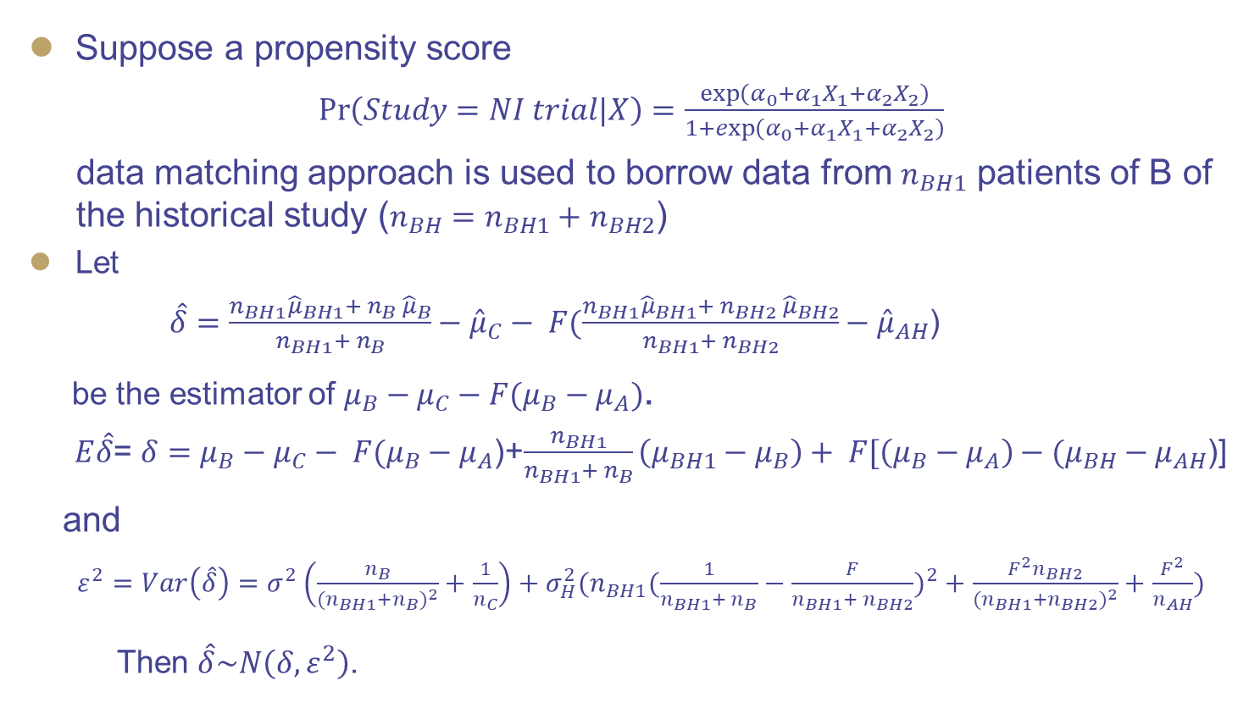
Propensity score data matching and borrowing
Suppose a propensity score
$\operatorname{Pr}\left(Study=NI trial|X\right)=\frac{\exp\left(α_{0}+α_{1}X_{1}+α_{2}X_{2}\right)}{1+\exp\left(α_{0}+α_{1}X_{1}+α_{2}X_{2}\right)}$
data matching approach is used to borrow data from $n_{BH1}$ patients of B of the historical study ($n_{BH}=n_{BH1}+$ $n_{BH2}$)
Let
$\hat{δ}=\frac{{n_{BH1}\hat{μ}}_{BH1}+ n_{B} {\hat{μ}}_{B}}{n_{BH1}+ n_{B}}−{\hat{μ}}_{C}− F(\frac{{n_{BH1}\hat{μ}}_{BH1}+ n_{BH2} {\hat{μ}}_{BH2}}{n_{BH1}+ n_{BH2}}−{\hat{μ}}_{AH}$)
be the estimator of ${μ_{B}−μ}_{C}−{F(μ_{B}−μ}_{A})$.
$E\hat{δ}$= $δ=μ_{B}−μ_{C}− F(μ_{B}−μ_{A}$)+$\frac{n_{BH1}}{n_{BH1}+ n_{B}}\left(μ_{BH1}−μ_{B}\right)+ F[\left(μ_{B}−μ_{A}\right)−(μ_{BH}−μ_{AH}$)]
and
${ε^{2}=Var\left(\hat{δ}\right)=σ}^{2}\left(\frac{n_{B}}{{(n}_{BH1}+n_{B})^{2}}+\frac{1}{n_{C}}\right)+σ_{H}^{2}(n_{BH1}(\frac{1}{n_{BH1}+ n_{B}}−\frac{F}{n_{BH1}+ n_{BH2}})^{2}+\frac{{F^{2}n}_{BH2}}{{(n}_{BH1}+n_{BH2})^{2}}+\frac{F^{2}}{n_{AH}})$
Then $\hat{δ}\sim N\left(δ,ε^{2}\right)$.

Slide 11
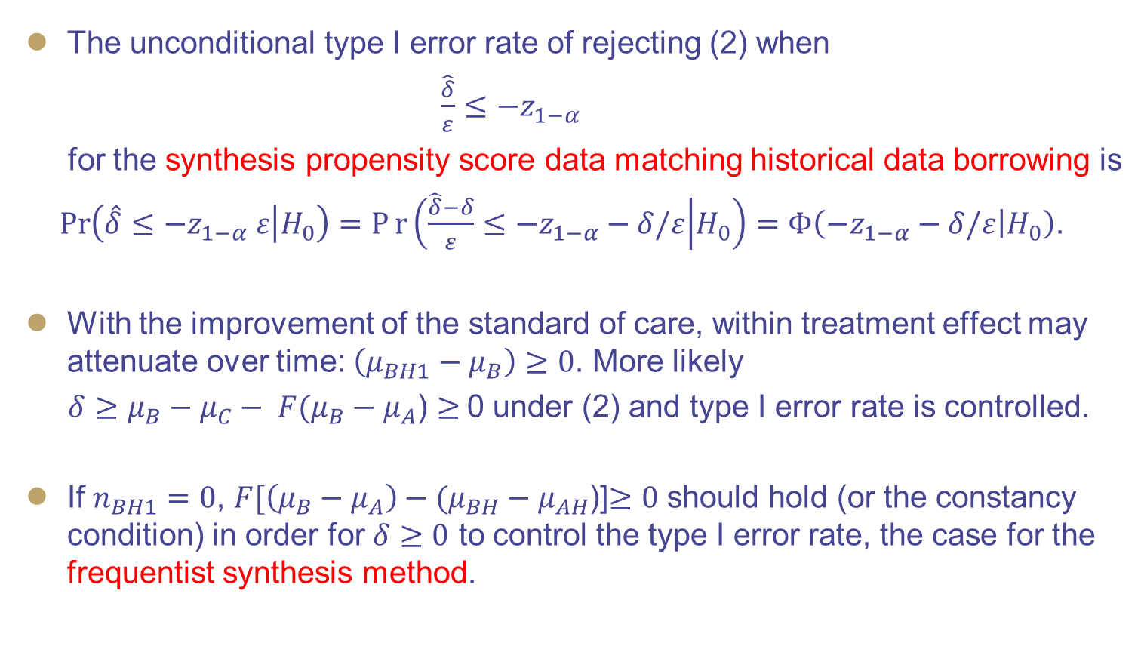
Unconditional type I error rate (1/2)
The unconditional type I error rate of rejecting (2) when
$\frac{\hat{δ}}{ε}≤{−z}_{1−α}$
for the synthesis propensity score data matching historical data borrowing is
$\operatorname{Pr}\left(\hat{δ}≤−z_{1−α} ε | H_{0}\right)=Pr\left(\frac{\hat{δ}−δ}{ε}≤−z_{1−α}−δ/ε | H_{0}\right)=Φ\left(−z_{1−α}−δ/ε | H_{0}\right)$.
With the improvement of the standard of care, within treatment effect may attenuate over time: $\left(μ_{BH1}−μ_{B}\right)≥0$. More likely
$δ≥μ_{B}−μ_{C}− F(μ_{B}−μ_{A}$) $≥$0 under (2) and type I error rate is controlled.
If $n_{BH1}=0$, $F[\left(μ_{B}−μ_{A}\right)−(μ_{BH}−μ_{AH}$)]$≥0$ should hold (or the constancy condition) in order for $δ≥0$ to control the type I error rate, the case for the frequentist synthesis method.

Slide 12
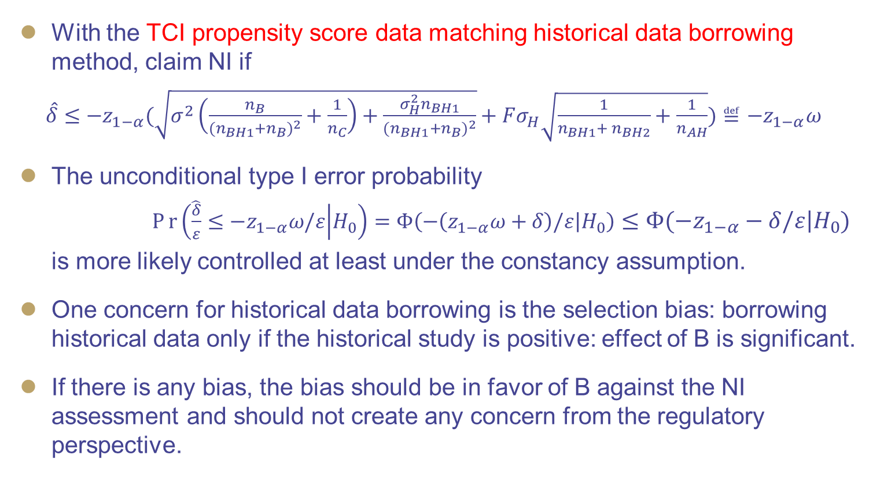
Unconditional type I error rate (2/2)
With the TCI propensity score data matching historical data borrowing method, claim NI if
$\hat{δ}≤{−z}_{1−α}(\sqrt{σ^{2}\left(\frac{n_{B}}{{(n}_{BH1}+n_{B})^{2}}+\frac{1}{n_{C}}\right)+\frac{{σ_{H}^{2}n}_{BH1}}{{(n}_{BH1}+n_{B})^{2}}}+Fσ_{H}\sqrt{\frac{1}{n_{BH1}+ n_{BH2}}+\frac{1}{n_{AH}}})≝{−z}_{1−α}ω$
The unconditional type I error probability
$Pr\left(\frac{\hat{δ}}{ε}≤{−z}_{1−α}ω/ε | H_{0}\right)=Φ\left(−\left(z_{1−α}ω+δ\right)/ε | H_{0}\right)≤Φ\left(−z_{1−α}−δ/ε | H_{0}\right)$
is more likely controlled at least under the constancy assumption.
One concern for historical data borrowing is the selection bias: borrowing historical data only if the historical study is positive: effect of B is significant.
If there is any bias, the bias should be in favor of B against the NI assessment and should not create any concern from the regulatory perspective.

Slide 13
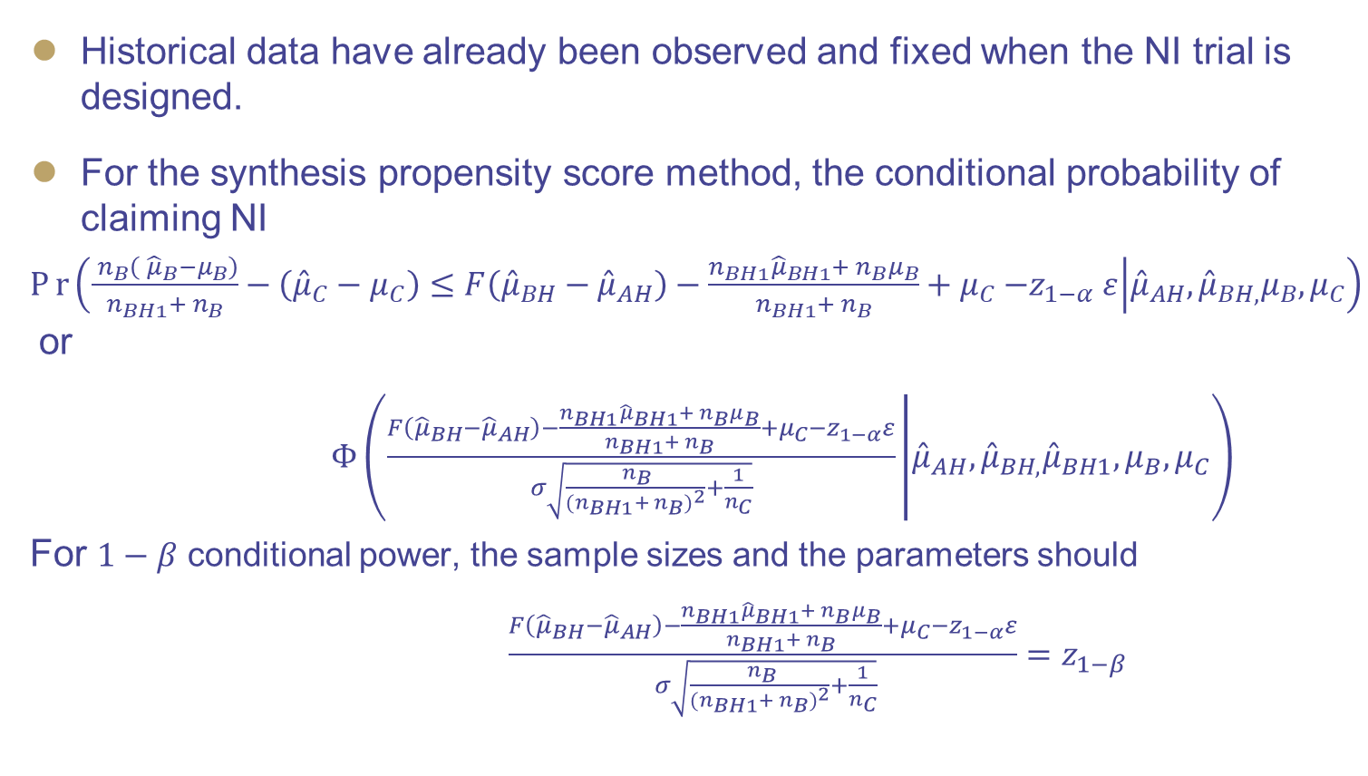
Conditional power and type I error probability (1/2)
Historical data have already been observed and fixed when the NI trial is designed.
For the synthesis propensity score method, the conditional probability of claiming NI
$Pr\left(\frac{ n_{B}\left( {\hat{μ}}_{B}−μ_{B}\right)}{n_{BH1}+ n_{B}}−\left({\hat{μ}}_{C}−μ_{C}\right)≤F\left({\hat{μ}}_{BH}−{\hat{μ}}_{AH}\right)−\frac{{n_{BH1}\hat{μ}}_{BH1}+ n_{B}μ_{B}}{n_{BH1}+ n_{B}}+μ_{C}{−z}_{1−α}ε | {\hat{μ}}_{AH},{\hat{μ}}_{BH,}μ_{B},μ_{C}\right)$ or
$Φ\left(\frac{F\left({\hat{μ}}_{BH}−{\hat{μ}}_{AH}\right)−\frac{{n_{BH1}\hat{μ}}_{BH1}+ n_{B}μ_{B}}{n_{BH1}+ n_{B}}+μ_{C}{−z}_{1−α}ε}{σ\sqrt{\frac{ n_{B}}{{(n}_{BH1}+ n_{B})^{2}}+\frac{1}{n_{C}}}} | {\hat{μ}}_{AH}, {\hat{μ}}_{BH,}{\hat{μ}}_{BH1},μ_{B},μ_{C}\right)$
For $1−β$ conditional power, the sample sizes and the parameters should
$\frac{F\left({\hat{μ}}_{BH}−{\hat{μ}}_{AH}\right)−\frac{{n_{BH1}\hat{μ}}_{BH1}+ n_{B}μ_{B}}{n_{BH1}+ n_{B}}+μ_{C}{−z}_{1−α}ε}{ σ\sqrt{\frac{ n_{B}}{{(n}_{BH1}+ n_{B})^{2}}+\frac{1}{n_{C}}}}{=z}_{1−β}$

Slide 14
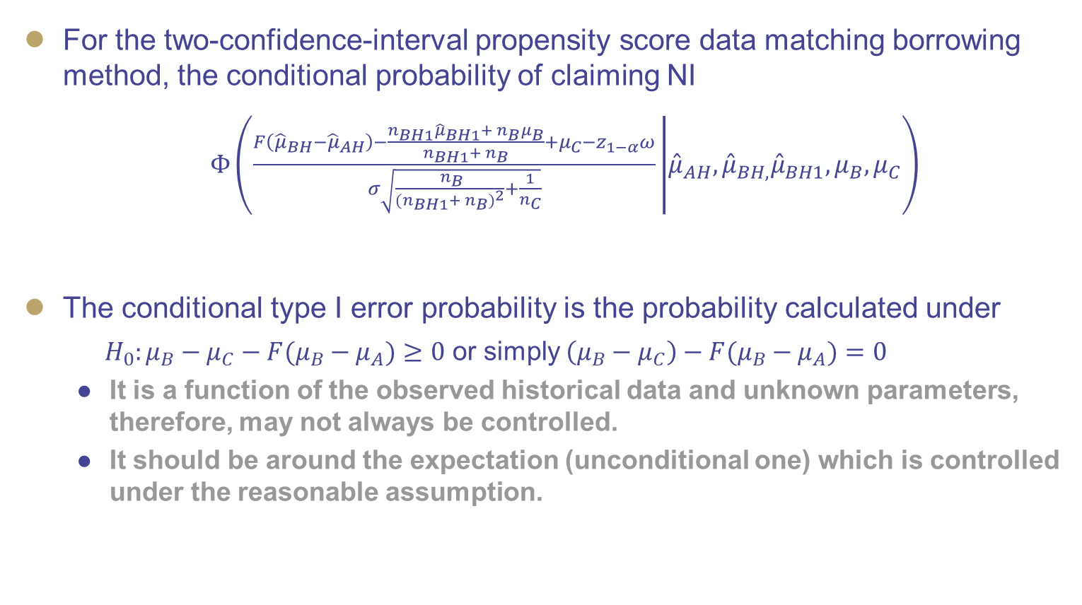
Conditional power and type I error probability (2/2)
For the two-confidence-interval propensity score data matching borrowing method, the conditional probability of claiming NI
$Φ\left(\frac{F\left({\hat{μ}}_{BH}−{\hat{μ}}_{AH}\right)−\frac{{n_{BH1}\hat{μ}}_{BH1}+ n_{B}μ_{B}}{n_{BH1}+ n_{B}}+μ_{C}−z_{1−α}ω}{σ\sqrt{\frac{ n_{B}}{{(n}_{BH1}+ n_{B})^{2}}+\frac{1}{n_{C}}}} | {\hat{μ}}_{AH},{\hat{μ}}_{BH,}{\hat{μ}}_{BH1},μ_{B},μ_{C}\right)$
The conditional type I error probability is the probability calculated under
${H_{0}:μ_{B}−μ}_{C}−{F(μ_{B}−μ}_{A})≥0$ or simply ${\left({μ_{B}−μ}_{C}\right)−F(μ_{B}−μ}_{A})=0$
It is a function of the observed historical data and unknown parameters, therefore, may not always be controlled.
It should be around the expectation (unconditional one) which is controlled under the reasonable assumption.

Slide 15
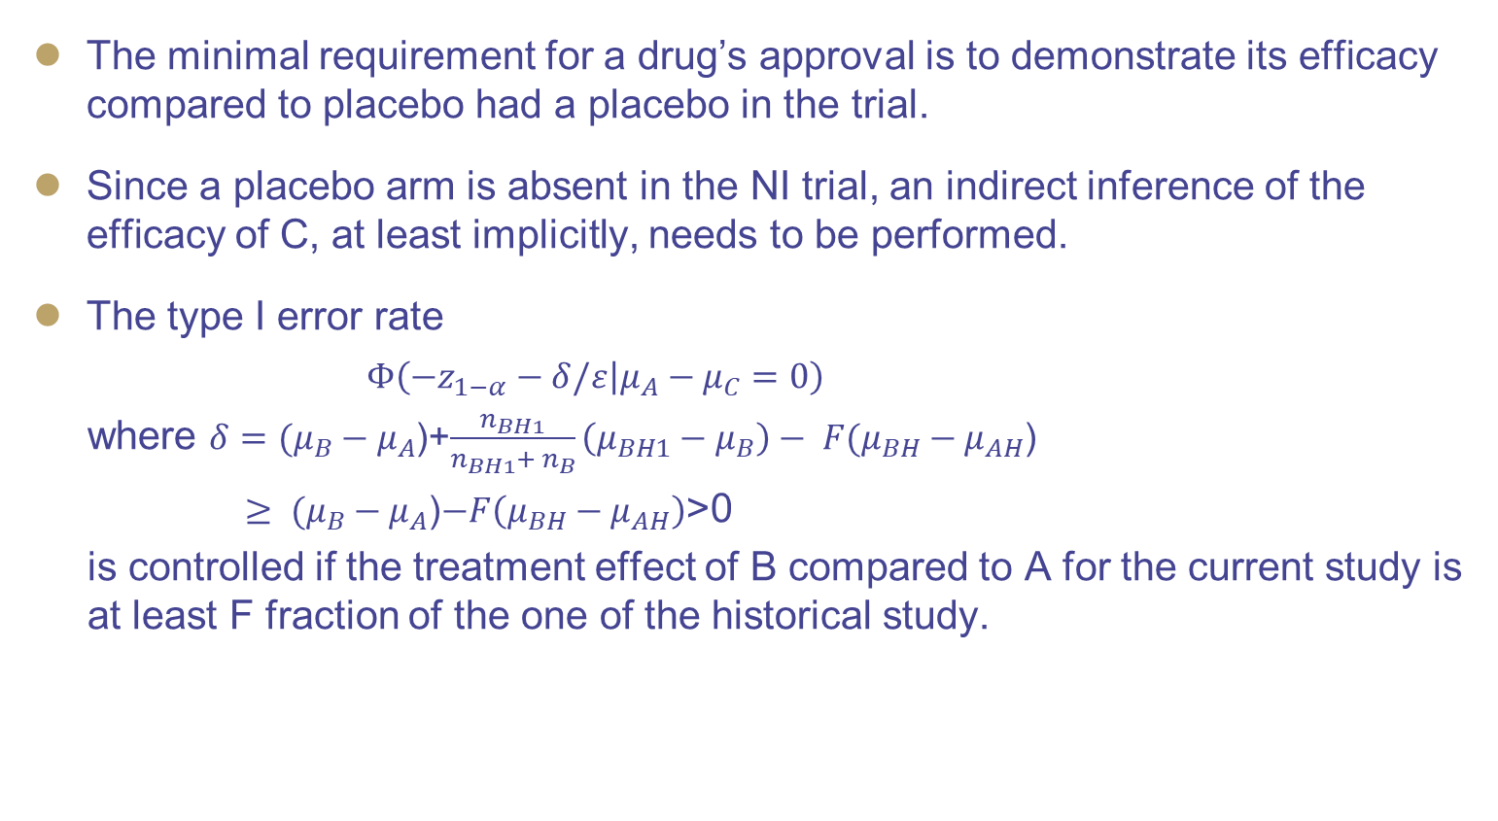
Type I error rate of claiming efficacy of C vs A
The minimal requirement for a drug’s approval is to demonstrate its efficacy compared to placebo had a placebo in the trial.
Since a placebo arm is absent in the NI trial, an indirect inference of the efficacy of C, at least implicitly, needs to be performed.
The type I error rate
$Φ\left(−z_{1−α}−δ/ε | {μ_{A}−μ}_{C}=0\right)$
where $δ=(μ_{B}−μ_{A}$)+$\frac{n_{BH1}}{n_{BH1}+ n_{B}}\left(μ_{BH1}−μ_{B}\right)− F(μ_{BH}−μ_{AH}$)
$≥ (μ_{B}−μ_{A}$)$−F\left(μ_{BH}−μ_{AH}\right)$>0
is controlled if the treatment effect of B compared to A for the current study is at least F fraction of the one of the historical study.

Slide 16
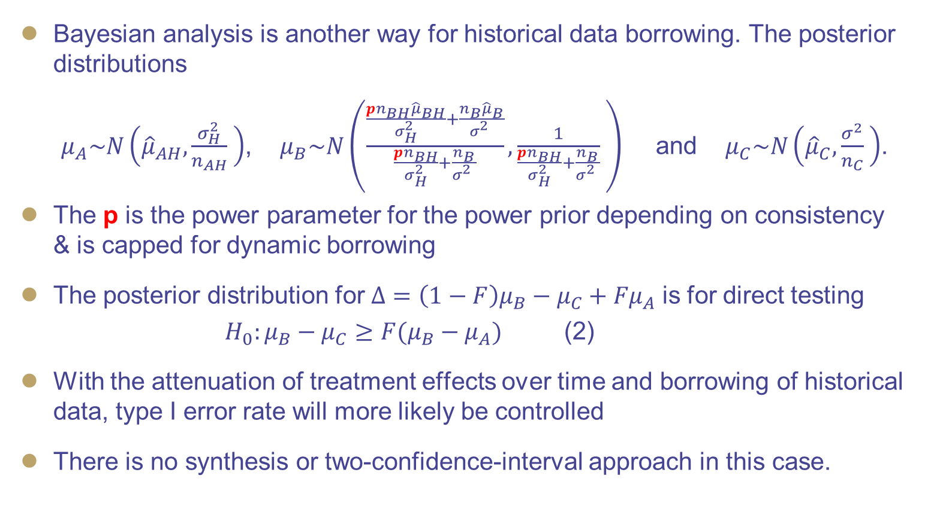
Bayesian method
Bayesian analysis is another way for historical data borrowing. The posterior distributions
$μ_{A}\sim N\left({\hat{μ}}_{AH},\frac{σ_{H}^{2}}{n_{AH}} \right)$, $μ_{B}\sim N\left(\frac{\frac{{{pn}_{BH}\hat{μ}}_{BH}}{σ_{H}^{2}}+\frac{{n_{B}\hat{μ}}_{B}}{σ_{}^{2}}}{\frac{pn_{BH}}{σ_{H}^{2}}+\frac{n_{B}}{σ_{}^{2}}},\frac{1}{\frac{{pn}_{BH}}{σ_{H}^{2}}+\frac{n_{B}}{σ_{}^{2}}} \right)$ and $μ_{C}\sim N\left({\hat{μ}}_{C},\frac{σ^{2}}{n_{C}} \right)$.
The p is the power parameter for the power prior depending on consistency & is capped for dynamic borrowing
The posterior distribution for $Δ={{\left(1−F\right)μ}_{B}−μ}_{C}+{Fμ}_{A}$ is for direct testing
${{ H}_{0}:μ_{B}−μ}_{C}≥{F(μ_{B}−μ}_{A})$ (2)
With the attenuation of treatment effects over time and borrowing of historical data, type I error rate will more likely be controlled
There is no synthesis or two-confidence-interval approach in this case.

Slide 17
Example (1/2)
A randomized trial with two primary endpoints, sample size was for the power for the first primary endpoint. The second primary endpoint will be used for the NI trial.
Half of the lower bound of the 95% CI 3.67/2=1.84 can be used as the NI margin for the frequentist TCI fixed margin design
 | Active (n=150) | Placebo (n=50) | Difference
Baseline (SD) | 55.41 (14.4) | 53.02 (15.7)
Treatment End (SD) | 58.93 (16.3) | 51.72 (14.9)
Change (95% CI) | 3.52 (2.91, 4.13) | −1.30 (−2.28, −0.32) | 4.82 (3.67, 5.97) (p<0.001)

Slide 18
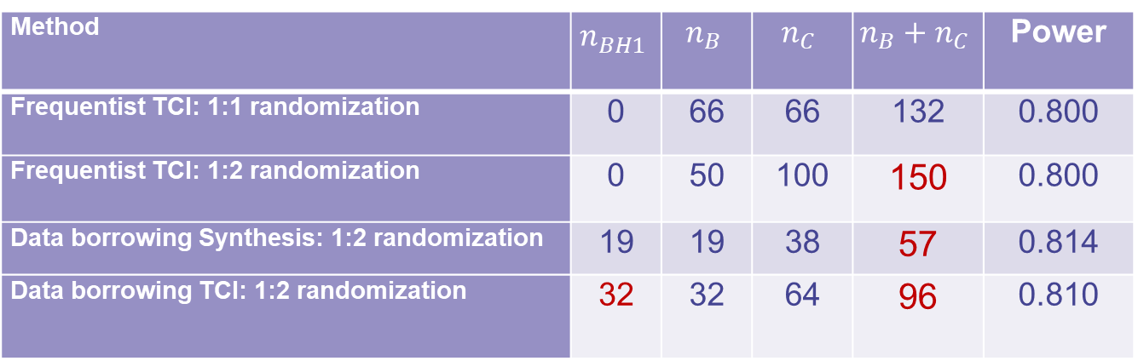
Example (2/2)
Overall SD=3.76, significance level=0.025, propensity score 1:1 matching data borrowing.
For 1:2, the sample size for the NI trial could be reduced from 150 to 96
Method | $$n_{BH1}^{}$$ | $$n_{B}$$ | $$n_{C}$$ | $$n_{B}+n_{C}$$ | Power
Frequentist TCI: 1:1 randomization | 0 | 66 | 66 | 132 | 0.800
Frequentist TCI: 1:2 randomization | 0 | 50 | 100 | 150 | 0.800
Data borrowing Synthesis: 1:2 randomization | 19 | 19 | 38 | 57 | 0.814
Data borrowing TCI: 1:2 randomization | 32 | 32 | 64 | 96 | 0.810

Slide 19
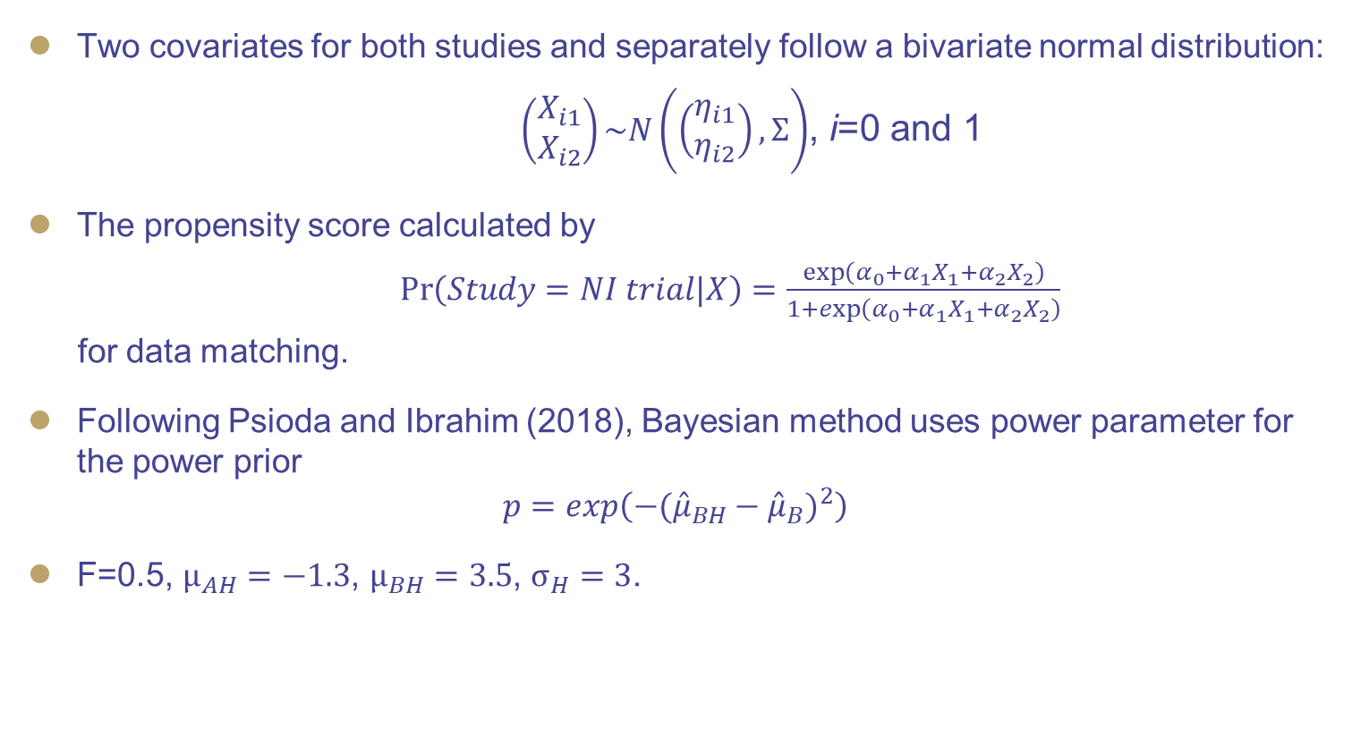
Simulation setting
Two covariates for both studies and separately follow a bivariate normal distribution:
$\left(\begin{matrix}X_{i1} \\ X_{i2}\end{matrix}\right)\sim N\left(\left(\begin{matrix}η_{i1} \\ η_{i2}\end{matrix}\right),Σ\right)$, i=0 and 1
The propensity score calculated by
$\operatorname{Pr}\left(Study=NI trial|X\right)=\frac{\exp\left(α_{0}+α_{1}X_{1}+α_{2}X_{2}\right)}{1+\exp\left(α_{0}+α_{1}X_{1}+α_{2}X_{2}\right)}$
for data matching.
Following Psioda and Ibrahim (2018), Bayesian method uses power parameter for the power prior
$${p=exp\left(−({\hat{μ}}_{BH}−{\hat{μ}}_{B})^{2}\right)}^{}$$
F=0.5, $μ_{AH}=−1.3$, $μ_{BH}=3.5$, $σ_{H}=3$.

Slide 20
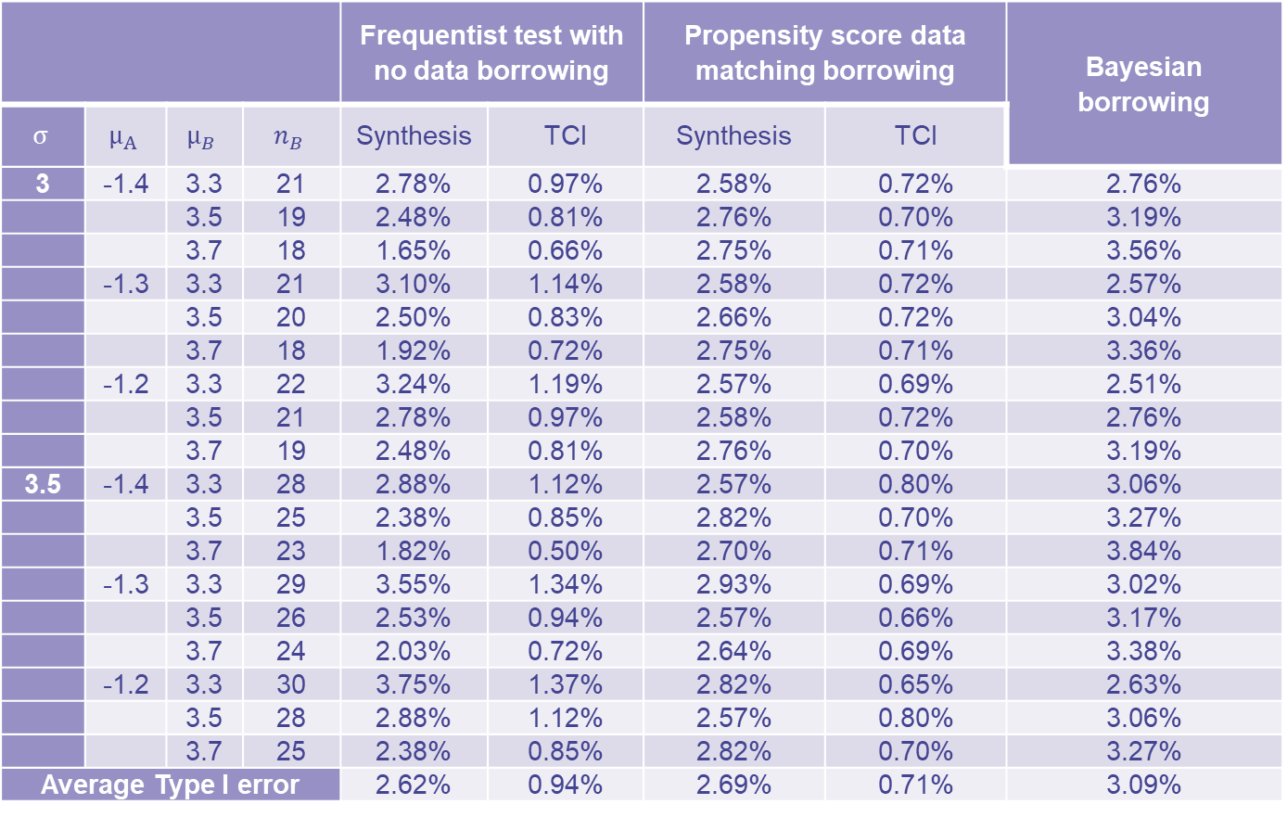
Simulation: Type I error probability for ($n_{B}=n_{C}) \& n_{BH1}≤n_{B}$
 |  |  |  | Frequentist test with no data borrowing |  | Propensity score data matching borrowing |  | Bayesian borrowing
$$σ$$ | $$μ_{A}$$ | $$μ_{B}$$ | $$n_{B}$$ | Synthesis | TCI | Synthesis | TCI
3 | -1.4 | 3.3 | 21 | 2.78% | 0.97% | 2.58% | 0.72% | 2.76%
 |  | 3.5 | 19 | 2.48% | 0.81% | 2.76% | 0.70% | 3.19%
 |  | 3.7 | 18 | 1.65% | 0.66% | 2.75% | 0.71% | 3.56%
 | -1.3 | 3.3 | 21 | 3.10% | 1.14% | 2.58% | 0.72% | 2.57%
 |  | 3.5 | 20 | 2.50% | 0.83% | 2.66% | 0.72% | 3.04%
 |  | 3.7 | 18 | 1.92% | 0.72% | 2.75% | 0.71% | 3.36%
 | -1.2 | 3.3 | 22 | 3.24% | 1.19% | 2.57% | 0.69% | 2.51%
 |  | 3.5 | 21 | 2.78% | 0.97% | 2.58% | 0.72% | 2.76%
 |  | 3.7 | 19 | 2.48% | 0.81% | 2.76% | 0.70% | 3.19%
3.5 | -1.4 | 3.3 | 28 | 2.88% | 1.12% | 2.57% | 0.80% | 3.06%
 |  | 3.5 | 25 | 2.38% | 0.85% | 2.82% | 0.70% | 3.27%
 |  | 3.7 | 23 | 1.82% | 0.50% | 2.70% | 0.71% | 3.84%
 | -1.3 | 3.3 | 29 | 3.55% | 1.34% | 2.93% | 0.69% | 3.02%
 |  | 3.5 | 26 | 2.53% | 0.94% | 2.57% | 0.66% | 3.17%
 |  | 3.7 | 24 | 2.03% | 0.72% | 2.64% | 0.69% | 3.38%
 | -1.2 | 3.3 | 30 | 3.75% | 1.37% | 2.82% | 0.65% | 2.63%
 |  | 3.5 | 28 | 2.88% | 1.12% | 2.57% | 0.80% | 3.06%
 |  | 3.7 | 25 | 2.38% | 0.85% | 2.82% | 0.70% | 3.27%
Average Type I error |  |  |  | 2.62% | 0.94% | 2.69% | 0.71% | 3.09%

Slide 21
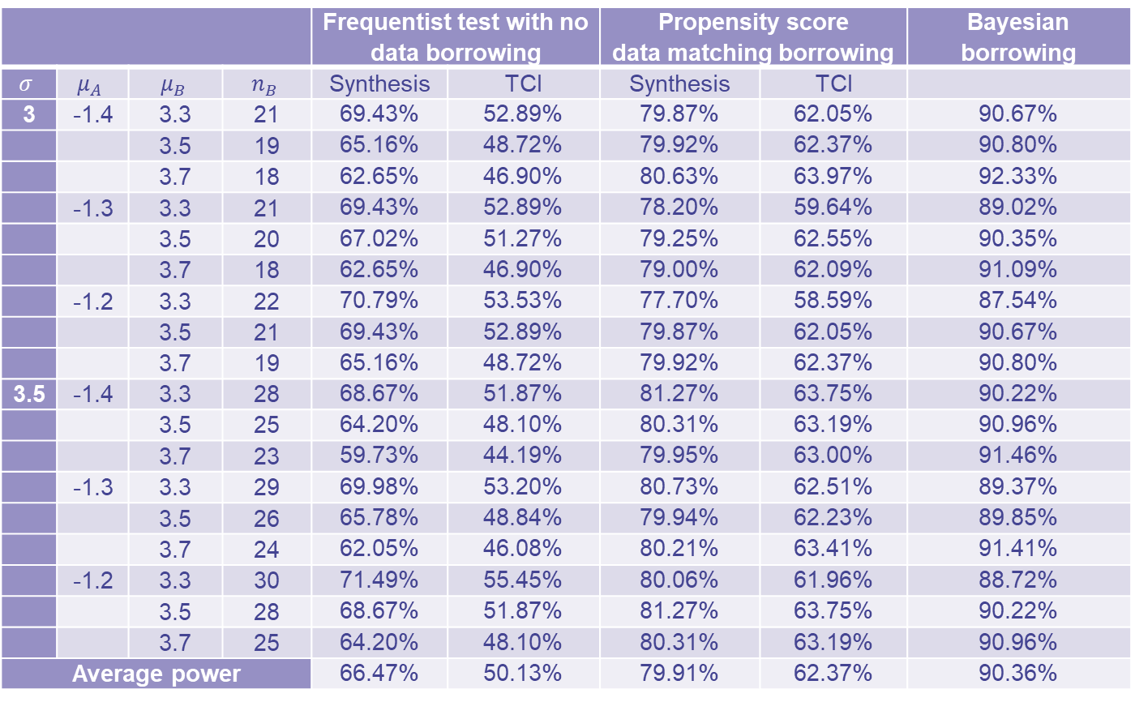
Simulation: Power for ($n_{B}=n_{C}) and n_{BH1}≤n_{B}$
 |  |  |  | Frequentist test with no data borrowing |  | Propensity score data matching borrowing |  | Bayesian borrowing
$$σ$$ | $$μ_{A}$$ | $$μ_{B}$$ | $$n_{B}$$ | Synthesis | TCI | Synthesis | TCI
3 | -1.4 | 3.3 | 21 | 69.43% | 52.89% | 79.87% | 62.05% | 90.67%
 |  | 3.5 | 19 | 65.16% | 48.72% | 79.92% | 62.37% | 90.80%
 |  | 3.7 | 18 | 62.65% | 46.90% | 80.63% | 63.97% | 92.33%
 | -1.3 | 3.3 | 21 | 69.43% | 52.89% | 78.20% | 59.64% | 89.02%
 |  | 3.5 | 20 | 67.02% | 51.27% | 79.25% | 62.55% | 90.35%
 |  | 3.7 | 18 | 62.65% | 46.90% | 79.00% | 62.09% | 91.09%
 | -1.2 | 3.3 | 22 | 70.79% | 53.53% | 77.70% | 58.59% | 87.54%
 |  | 3.5 | 21 | 69.43% | 52.89% | 79.87% | 62.05% | 90.67%
 |  | 3.7 | 19 | 65.16% | 48.72% | 79.92% | 62.37% | 90.80%
3.5 | -1.4 | 3.3 | 28 | 68.67% | 51.87% | 81.27% | 63.75% | 90.22%
 |  | 3.5 | 25 | 64.20% | 48.10% | 80.31% | 63.19% | 90.96%
 |  | 3.7 | 23 | 59.73% | 44.19% | 79.95% | 63.00% | 91.46%
 | -1.3 | 3.3 | 29 | 69.98% | 53.20% | 80.73% | 62.51% | 89.37%
 |  | 3.5 | 26 | 65.78% | 48.84% | 79.94% | 62.23% | 89.85%
 |  | 3.7 | 24 | 62.05% | 46.08% | 80.21% | 63.41% | 91.41%
 | -1.2 | 3.3 | 30 | 71.49% | 55.45% | 80.06% | 61.96% | 88.72%
 |  | 3.5 | 28 | 68.67% | 51.87% | 81.27% | 63.75% | 90.22%
 |  | 3.7 | 25 | 64.20% | 48.10% | 80.31% | 63.19% | 90.96%
Average power |  |  |  | 66.47% | 50.13% | 79.91% | 62.37% | 90.36%

Slide 22
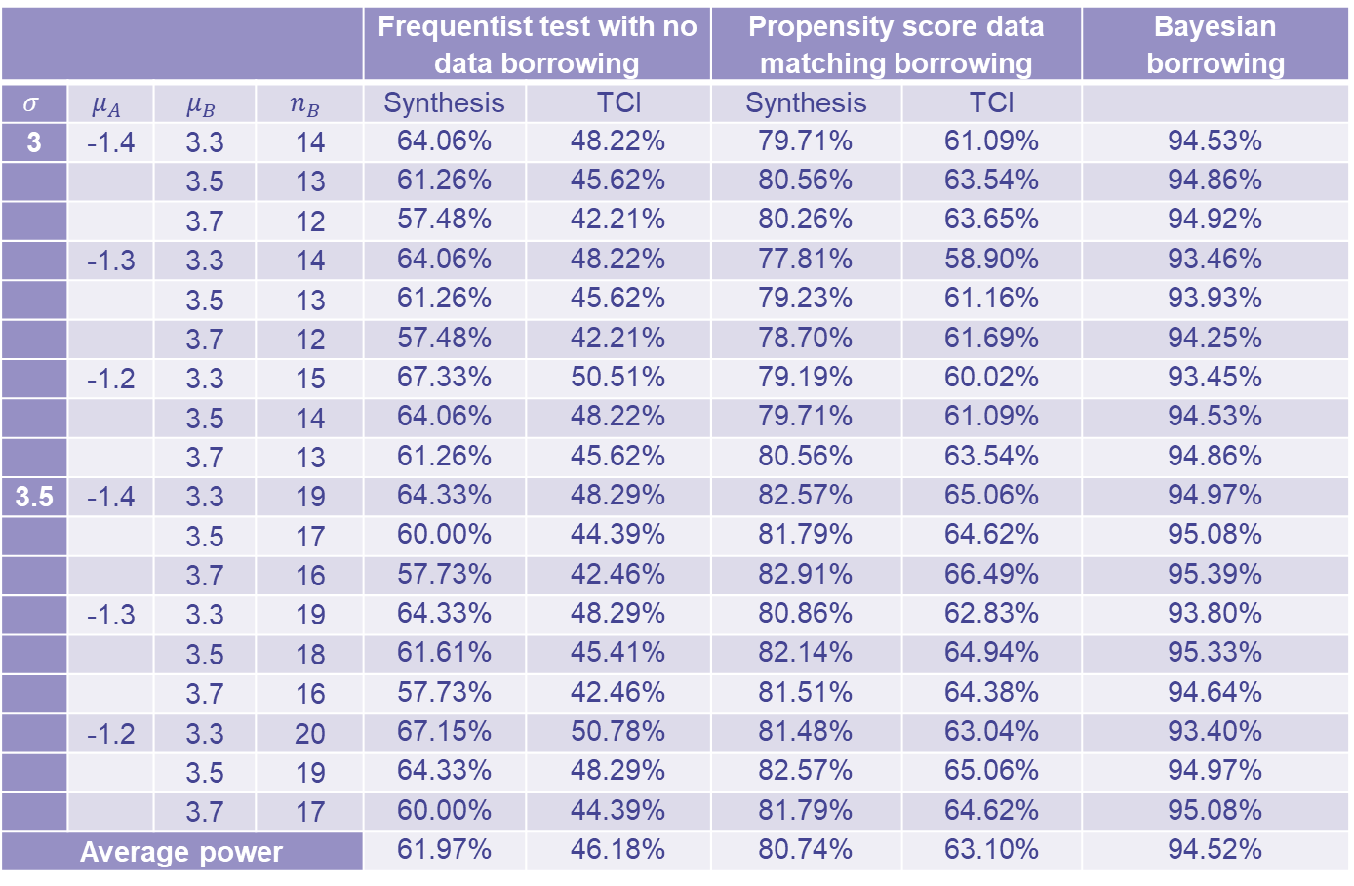
Simulation: Power for (2$n_{B}=n_{C}) and n_{BH1}≤n_{B}$
 |  |  |  | Frequentist test with no data borrowing |  | Propensity score data matching borrowing |  | Bayesian borrowing
$$σ$$ | $$μ_{A}$$ | $$μ_{B}$$ | $$n_{B}$$ | Synthesis | TCI | Synthesis | TCI
3 | -1.4 | 3.3 | 14 | 64.06% | 48.22% | 79.71% | 61.09% | 94.53%
 |  | 3.5 | 13 | 61.26% | 45.62% | 80.56% | 63.54% | 94.86%
 |  | 3.7 | 12 | 57.48% | 42.21% | 80.26% | 63.65% | 94.92%
 | -1.3 | 3.3 | 14 | 64.06% | 48.22% | 77.81% | 58.90% | 93.46%
 |  | 3.5 | 13 | 61.26% | 45.62% | 79.23% | 61.16% | 93.93%
 |  | 3.7 | 12 | 57.48% | 42.21% | 78.70% | 61.69% | 94.25%
 | -1.2 | 3.3 | 15 | 67.33% | 50.51% | 79.19% | 60.02% | 93.45%
 |  | 3.5 | 14 | 64.06% | 48.22% | 79.71% | 61.09% | 94.53%
 |  | 3.7 | 13 | 61.26% | 45.62% | 80.56% | 63.54% | 94.86%
3.5 | -1.4 | 3.3 | 19 | 64.33% | 48.29% | 82.57% | 65.06% | 94.97%
 |  | 3.5 | 17 | 60.00% | 44.39% | 81.79% | 64.62% | 95.08%
 |  | 3.7 | 16 | 57.73% | 42.46% | 82.91% | 66.49% | 95.39%
 | -1.3 | 3.3 | 19 | 64.33% | 48.29% | 80.86% | 62.83% | 93.80%
 |  | 3.5 | 18 | 61.61% | 45.41% | 82.14% | 64.94% | 95.33%
 |  | 3.7 | 16 | 57.73% | 42.46% | 81.51% | 64.38% | 94.64%
 | -1.2 | 3.3 | 20 | 67.15% | 50.78% | 81.48% | 63.04% | 93.40%
 |  | 3.5 | 19 | 64.33% | 48.29% | 82.57% | 65.06% | 94.97%
 |  | 3.7 | 17 | 60.00% | 44.39% | 81.79% | 64.62% | 95.08%
Average power |  |  |  | 61.97% | 46.18% | 80.74% | 63.10% | 94.52%

Slide 23
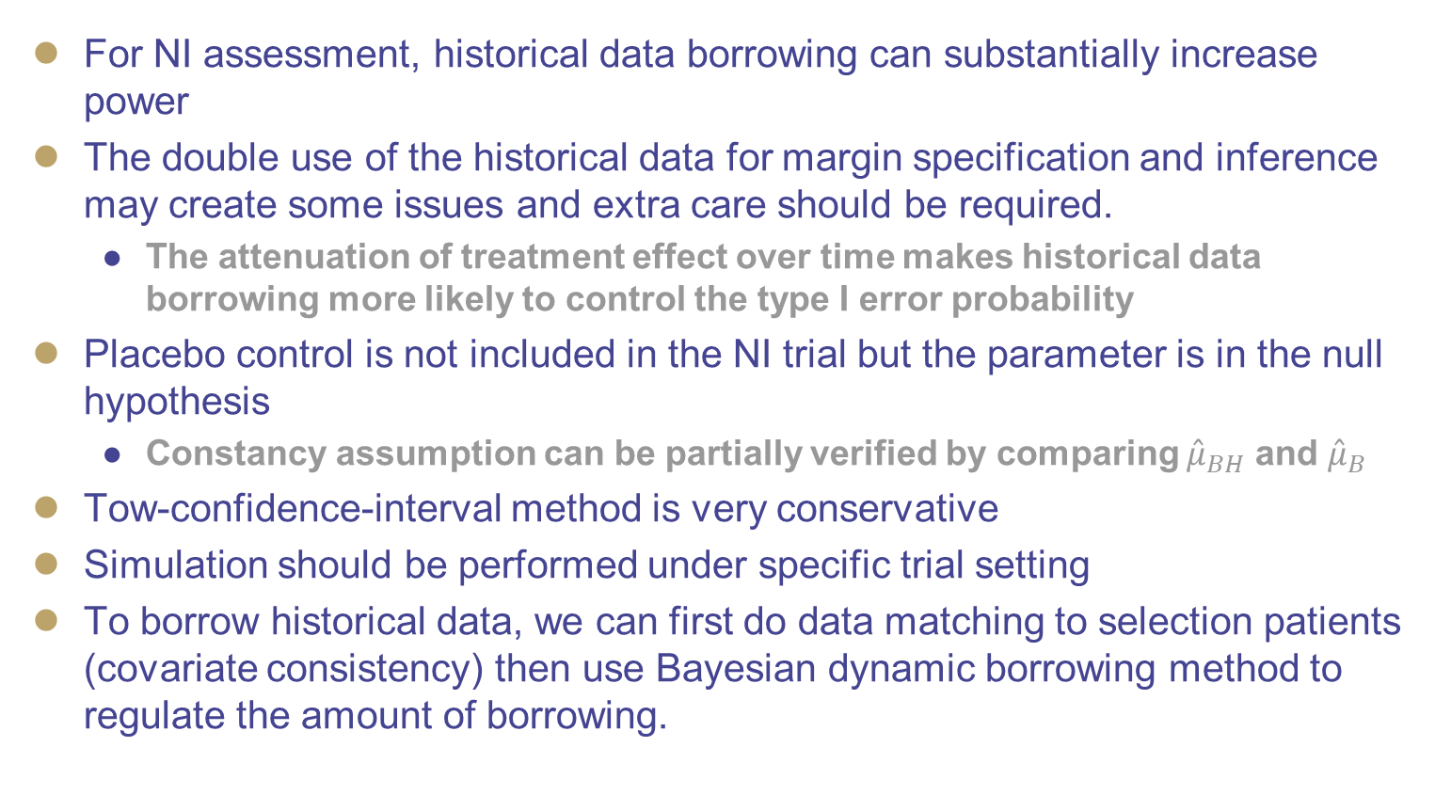
Discussion
For NI assessment, historical data borrowing can substantially increase power
The double use of the historical data for margin specification and inference may create some issues and extra care should be required.
The attenuation of treatment effect over time makes historical data borrowing more likely to control the type I error probability
Placebo control is not included in the NI trial but the parameter is in the null hypothesis
Constancy assumption can be partially verified by comparing ${\hat{μ}}_{BH}$ and ${\hat{μ}}_{B}$
Tow-confidence-interval method is very conservative
Simulation should be performed under specific trial setting
To borrow historical data, we can first do data matching to selection patients (covariate consistency) then use Bayesian dynamic borrowing method to regulate the amount of borrowing.

Slide 24
Major references
US FDA, Non-Inferiority Clinical Trials to Establish Effectiveness: Guidance for Industry (November 2016). Available at https://www.fda.gov/media/78504/download, accessed date: August 6, 2020.
S.H Kang, Avoiding ambiguity with the Type I error rate in noninferiority trials. Journal of Biopharmaceutical Statistics. 26 (2016) 452-465.
H.M.Hung, S.J Wang and R O’Neill. Issues with statistical risks for testing methods in noninferiority trial without a placebo arm. Journal of Biopharmaceutical Statistics. 17 (2007) 201-213.
S. Y. Wang and S. H. Kang. Strength of evidence of noninferiority trials with the two confidence interval method with random margin. 23 (2013) 307-321.
US FDA, Interacting with the FDA on Complex Innovative Trial Designs for Drugs and Biological Products: Draft Draft Guidance for Industry (September 2019) Available at https://www.fda.gov/media/130897/download, accessed date: August 6, 2020..
M H Chen, J G Ibrhim, P Lam, A Yu, and Y Zhang. Bayesian design of noninferiority trials for medical devices using historical data. Biometrics. 67 (2011) 1163-1170.
D Dejardin, P Delmar, C Warne, K Patel, JV Rosmalen and E Lesaffre. Use of a historical control group in a noninferiority trial assessing a new antibacterial treatment: a case study and discussion of practical implementation aspects. Pharmaceutical Statistics. 17 (2018) 169-181.
S. Pocock, The combination of randomized and historical controls in clinical trials, Journal of Chronic Diseases. 29 (1976) 175-188.
B.P. Hobbs, B.P. Carlin, S.J. Mandrekar and D.J. Sargent, Hierarchical commensurate and power prior models for adaptive incorporation of historical information in clinical trials, Biometrics 67 (2011) 1047-1056.
H. Quan, B. Zhang, Y Lan, X Luo and X Chen. Bayesian hypothesis testing with frequentist characteristics. Contemporary Clinical Trials. 2019.
M.A. Psioda and J.G.Ibrahim, Bayesian clinical trial design using historical data that inform the treatment effect, Biostatistics 2018. Doi: 10.1093/biostatistics/kxy009.

Slide 25
Thank you!

